Slide 1

PyGame Primer

Slide 2
What’s the point of this primer
To give you the essential (read: minimum) knowledge on PyGame to help you get started making you games and completing the in2Science CS course!
Further reading: https://inventwithpython.com/makinggames.pdf

Slide 3
What is PyGame?
A module that allows you to make games in Python (pretty much in the tbh…)
To download onto your PC, please follow the instructions at:
https://www.youtube.com/watch?v=1FekDMDome4

Slide 4
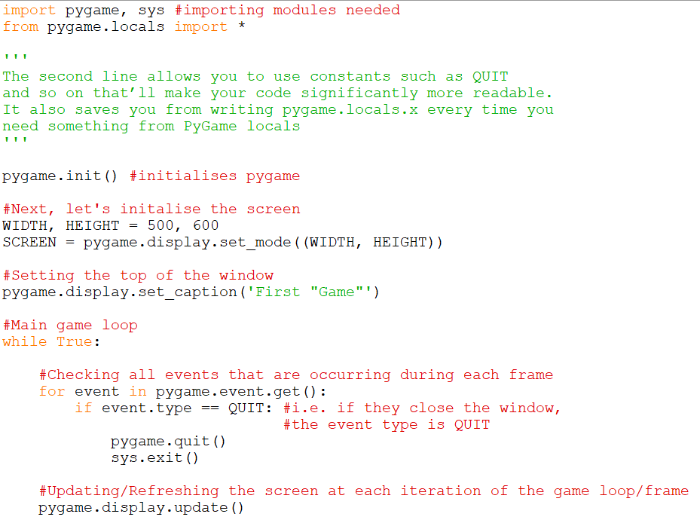
Let’s get started! (write the following)

Slide 5
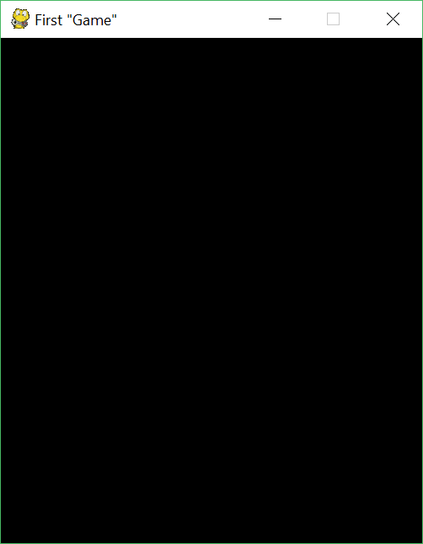
Result
Congrats! You’ve successfully created the dullest game in history ☺

Slide 6
How to represent colour
As with all GUI modules/technologies, colour can be broken down into 3 components – Red, Green & Blue (i.e. the primary colours)
These 3 components can each have a value from 0 – 255 inclusive.
In PyGame, we store colours as a tuple with 3 values.

Slide 7
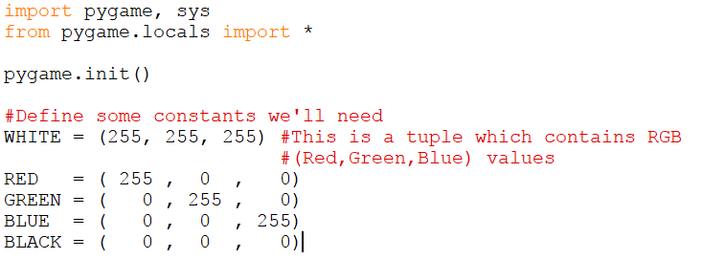
Some common colours
Please note that I will use red ellipses throughout this presentation to highlight the most important bits of code.
To get the RGB values for other colours, type in ‘colour picker’ into Google.

Slide 8
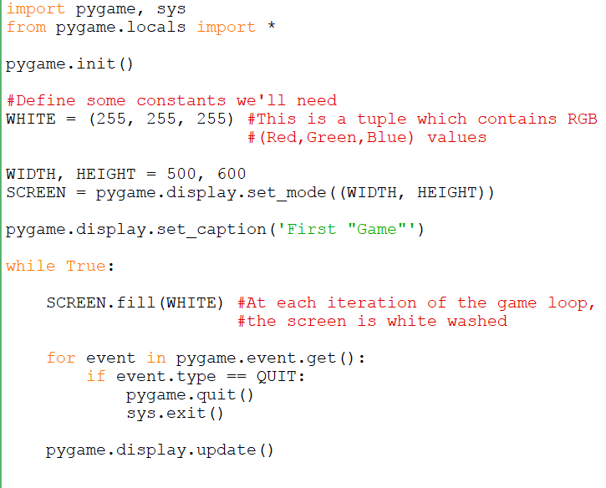
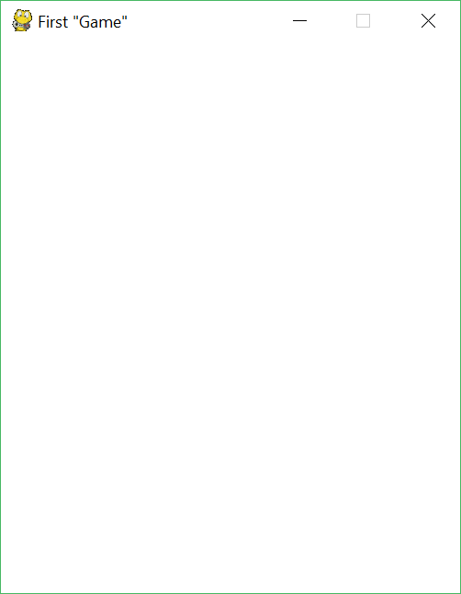
How to get a blank (white) screen
Code
Result
Please note that SCREEN and the Surface (upon which we’ll add stuff) will be used interchangeably

Slide 9
Axis
Before we go on to draw stuff, let’s have a quick look at how the axis/coordinate system used in PyGame (and indeed most other game engines!)
Normally, we use the cartesian system (i.e. x and y axis’)
PyGame however inverts the y-axis. Also, the origin (0, 0) is the top-left hand corner of the PyGame screen.

Slide 10
y
Cartesian coordinates
4
x
O
x
3

Slide 11
O
3
x
4
x
PyGame coordinate system
y

Slide 12
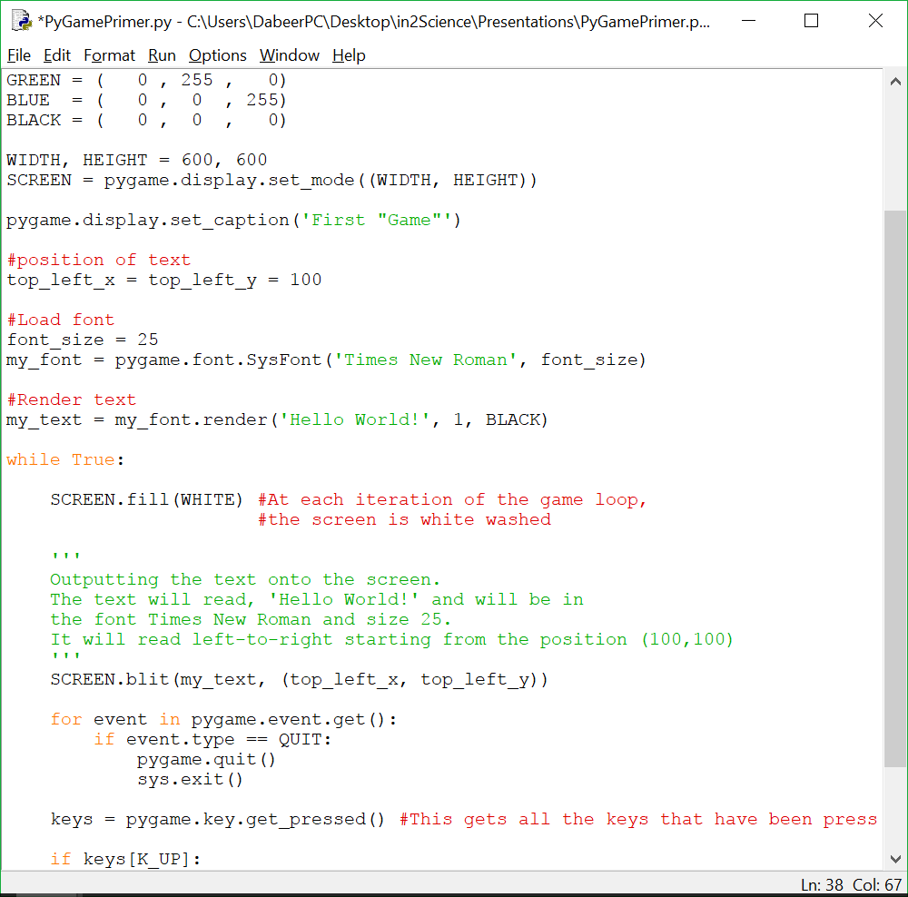
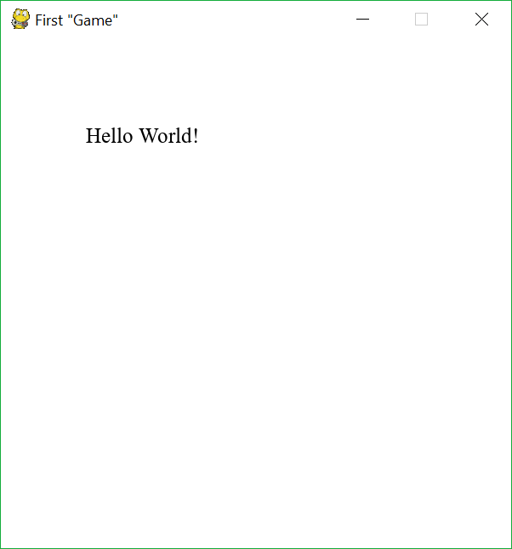
Outputting text onto the screen

Slide 13
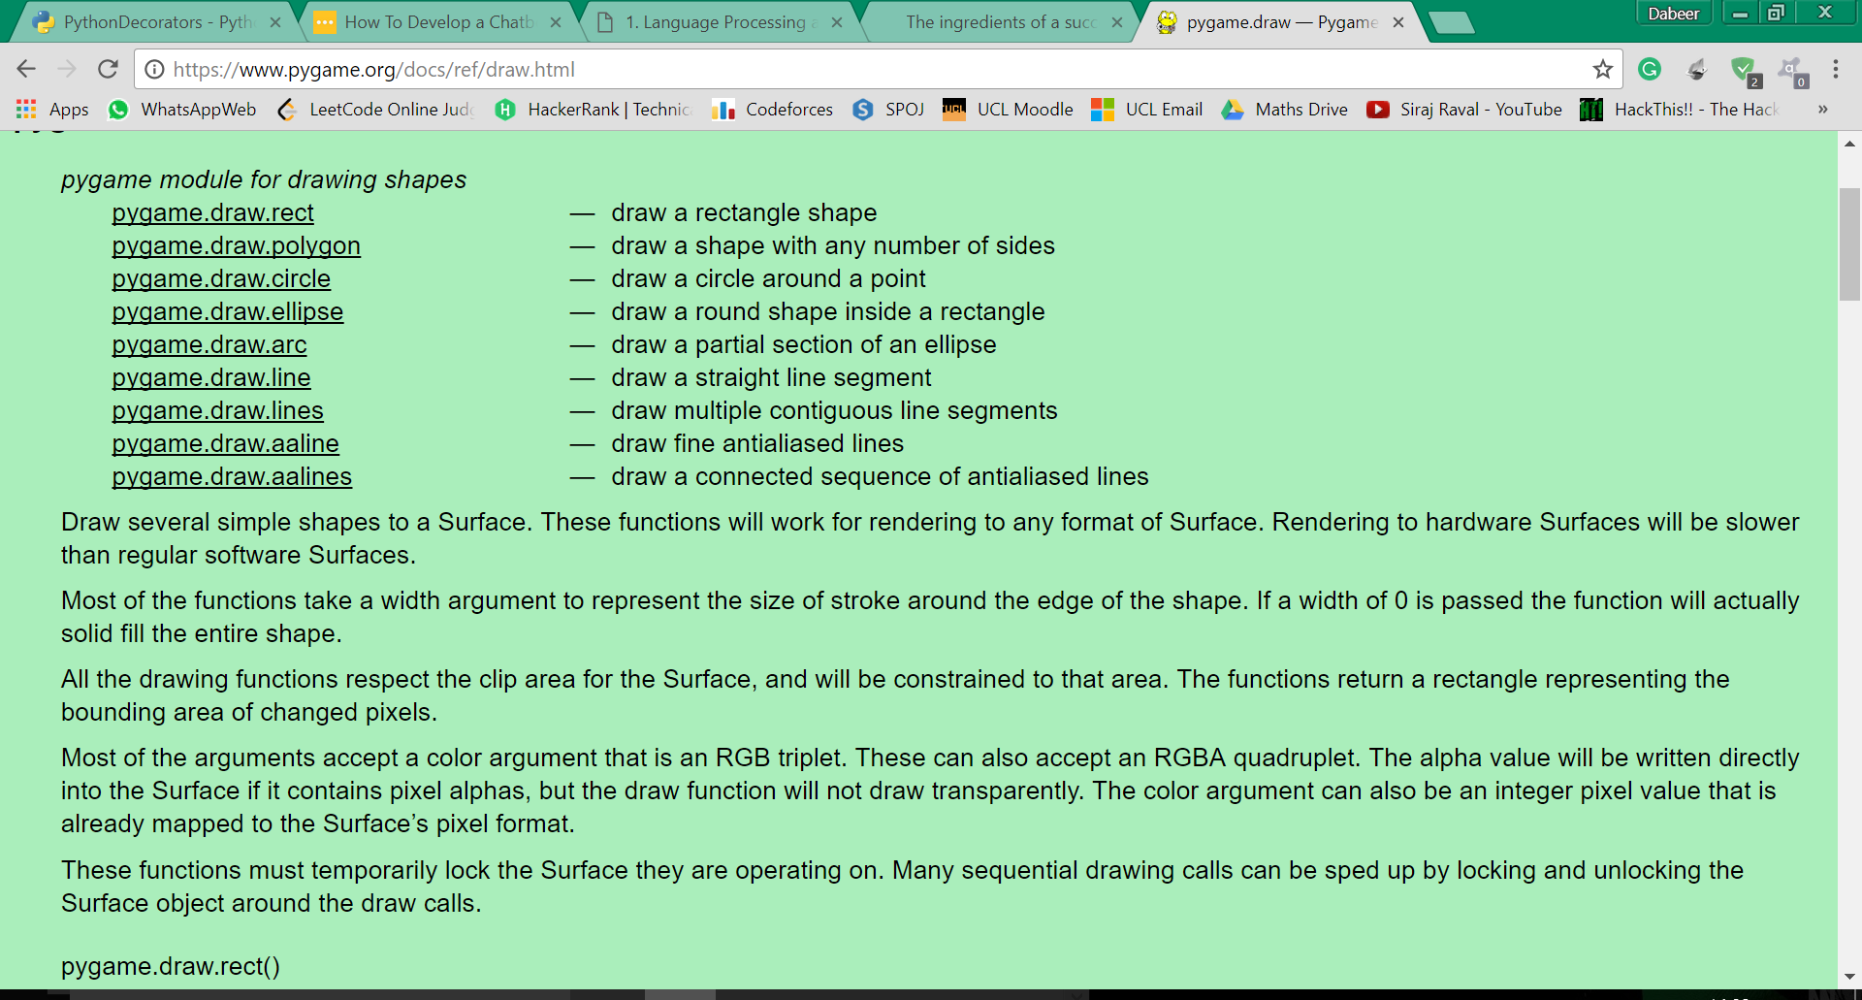
How to draw shapes
These are the methods that you need to use to create shapes in PyGame.
In the following slides, I’ll demonstrate in detail how to use some of these functions (the useful ones anyway!).
For an in depth explanation, please visit: https://www.pygame.org/docs/ref/draw.html

Slide 14
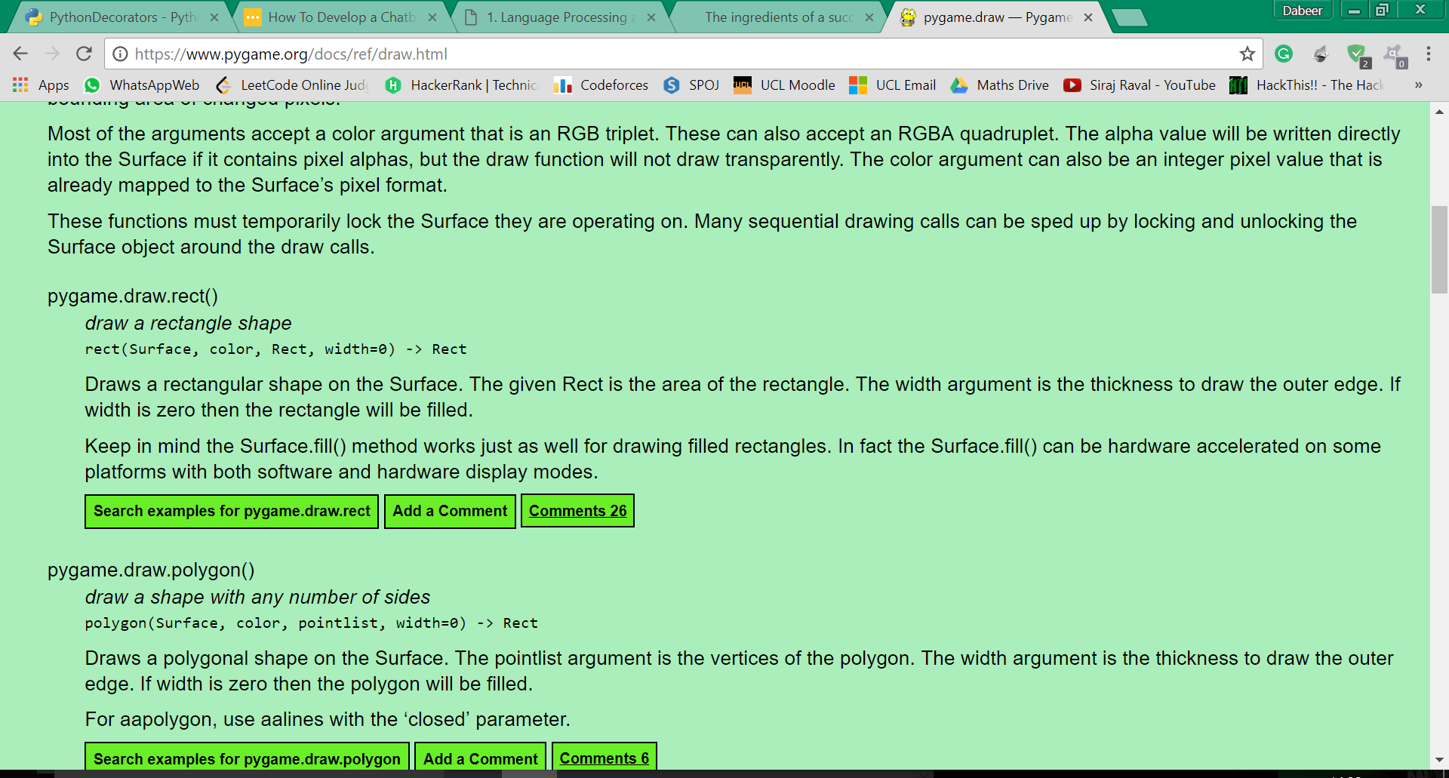
Drawing rectangle overview

Slide 15
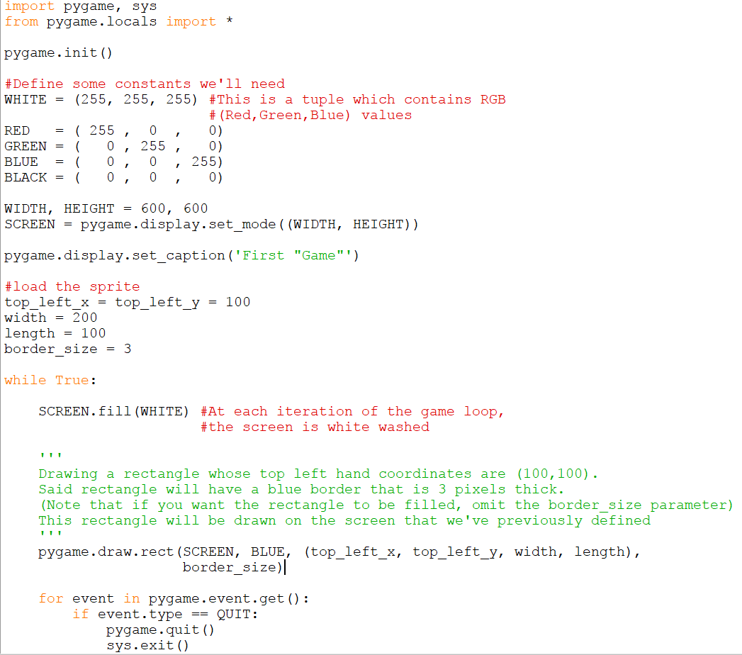
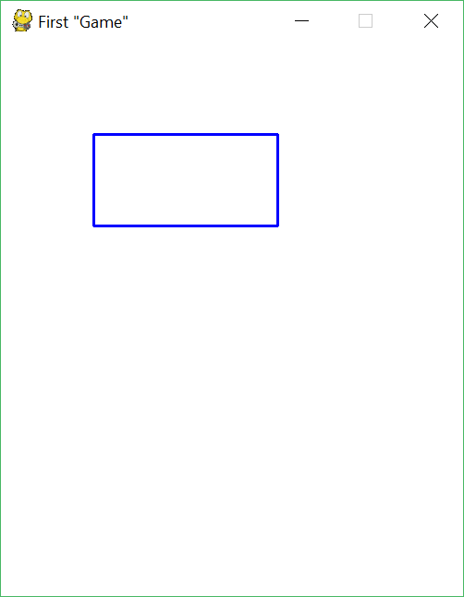
Drawing a rectangle example (1)

Slide 16
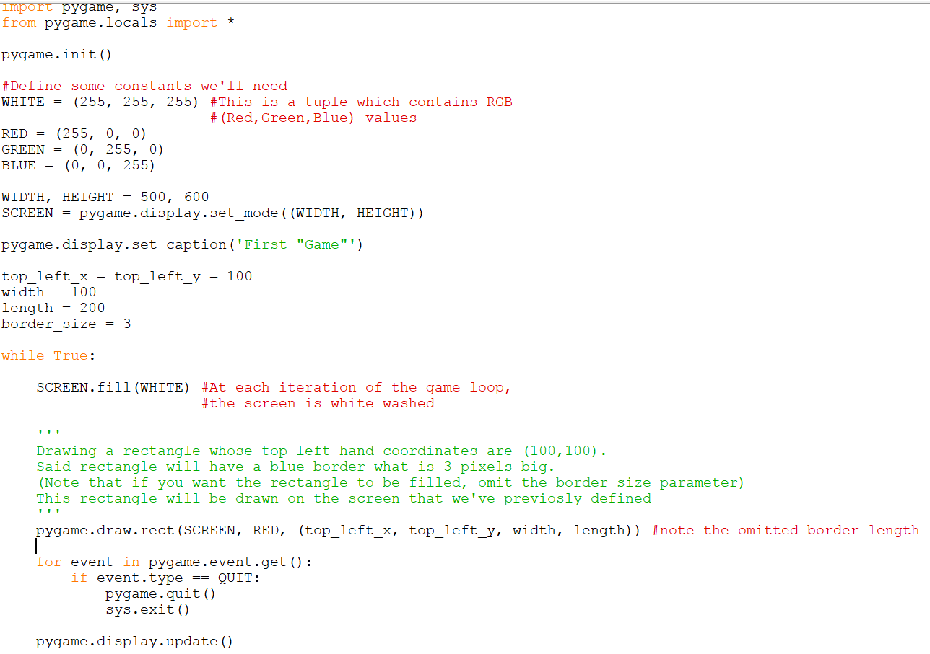
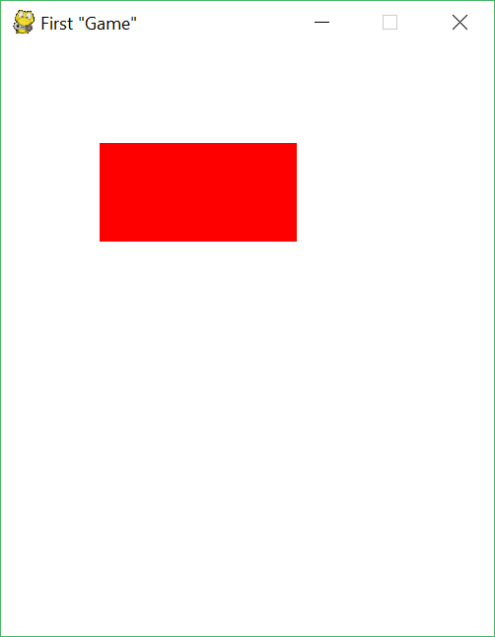
Drawing rectangle example (2)

Slide 17
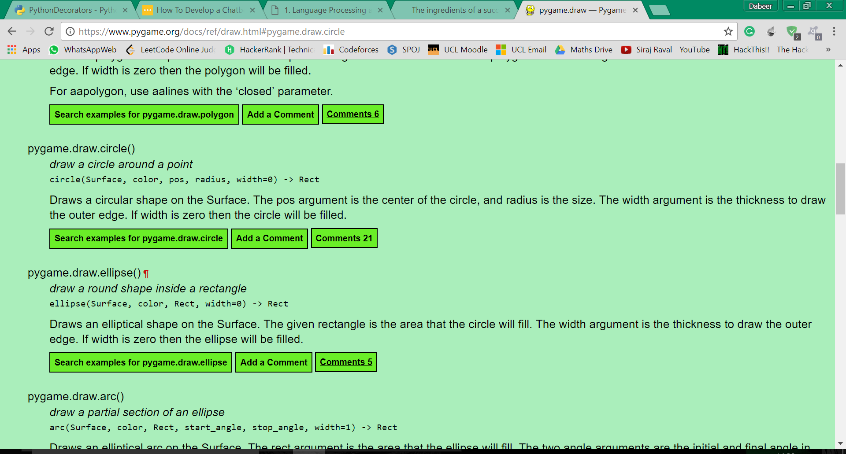
Drawing a circle overview

Slide 18
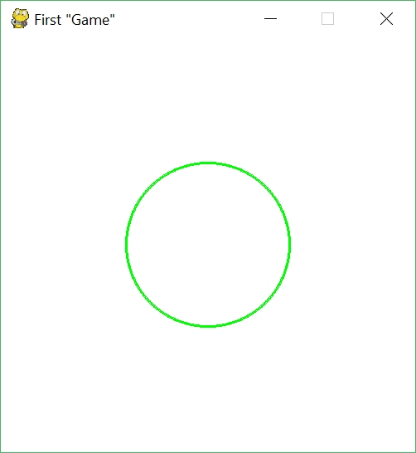
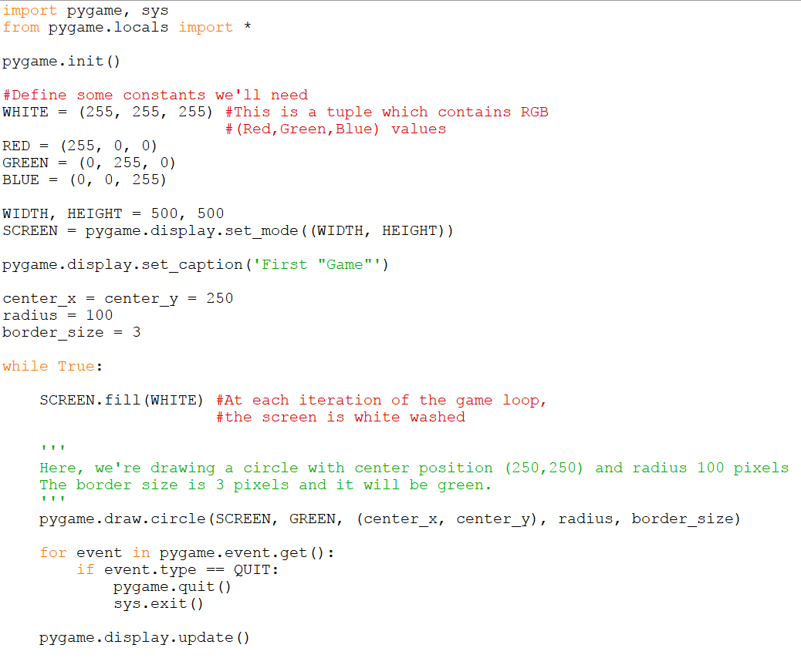
Drawing circle example (1)

Slide 19
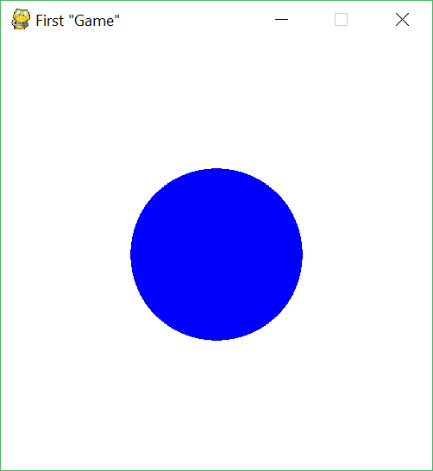
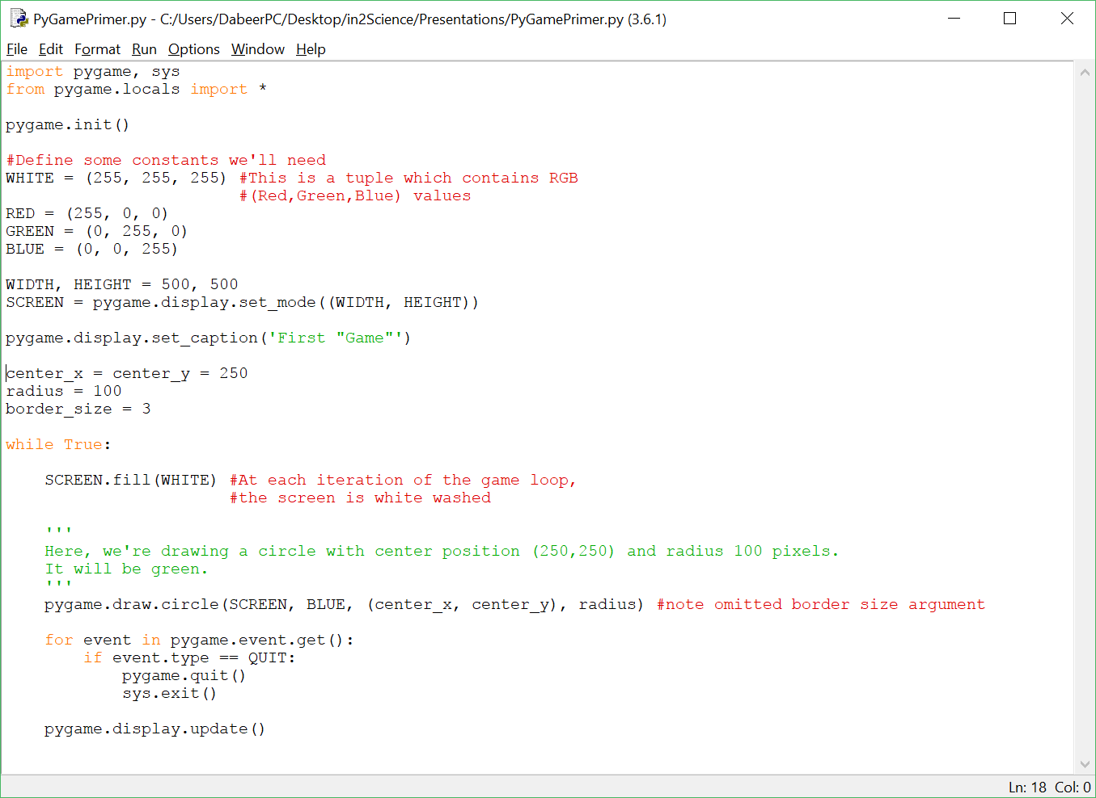
Drawing circle example (2)

Slide 20
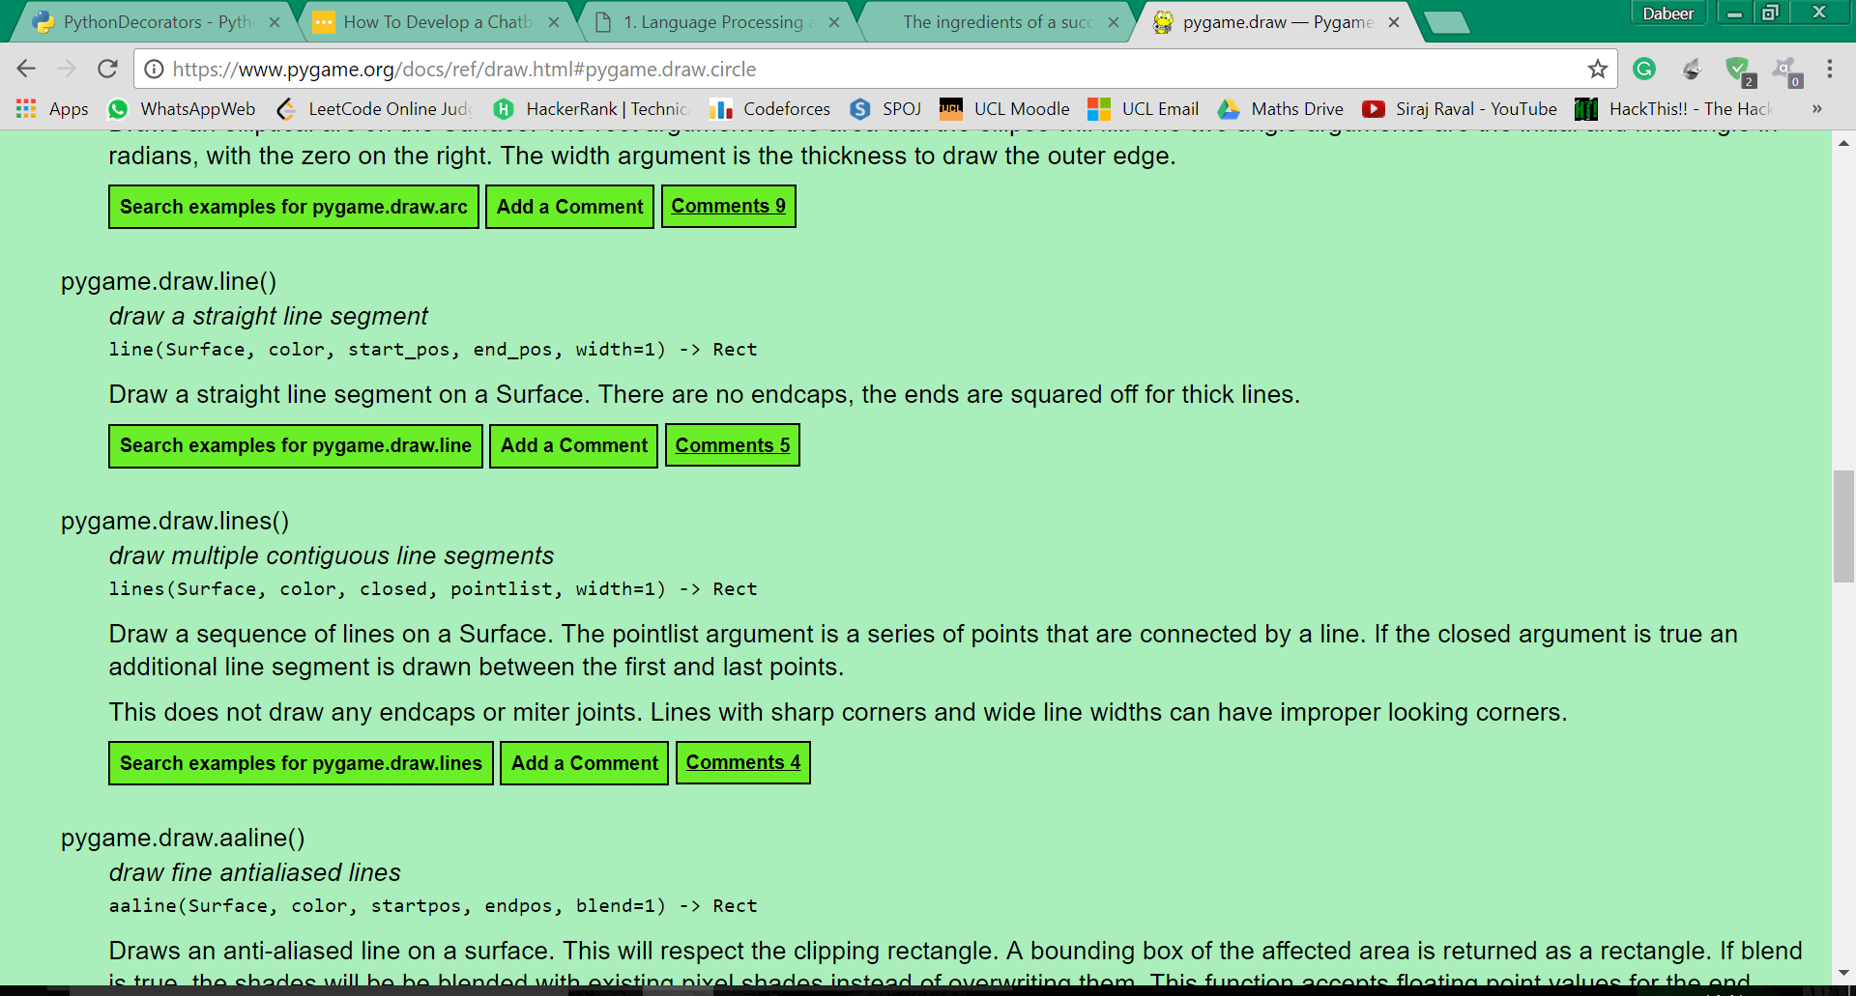
Drawing lines overview

Slide 21
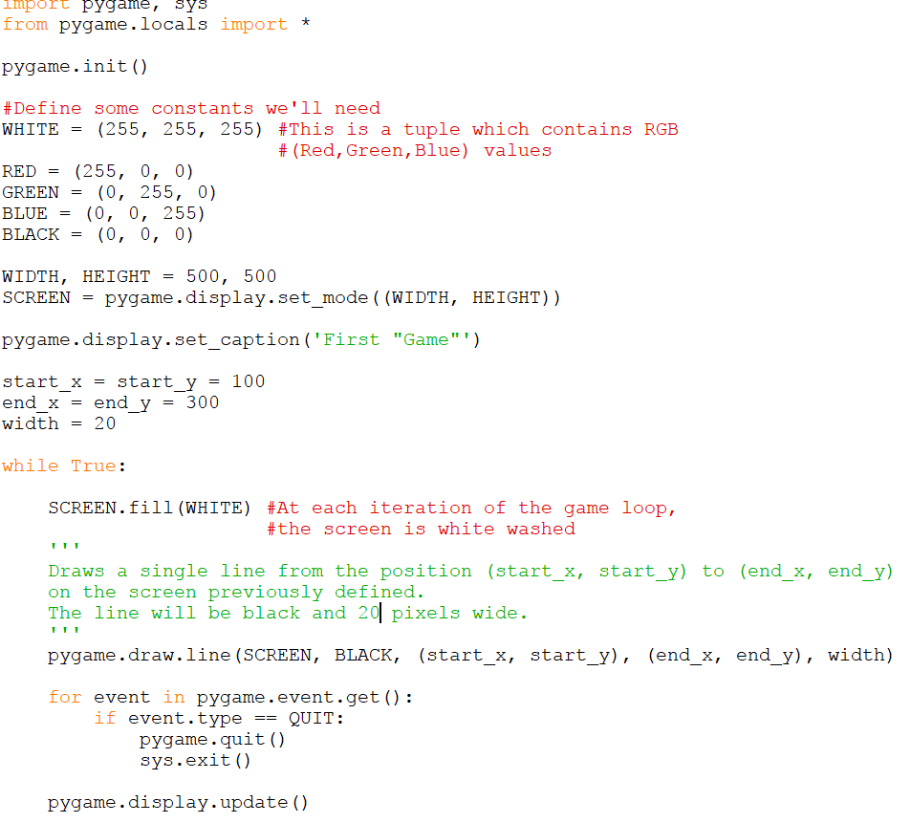
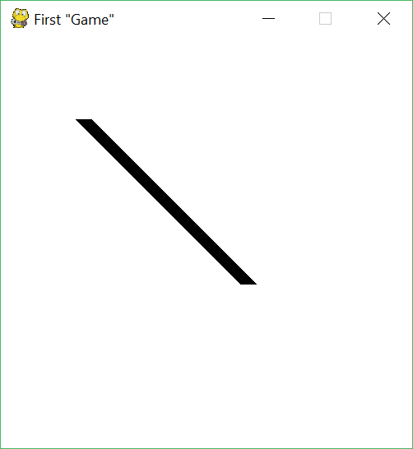
Drawing a line example (1)

Slide 22
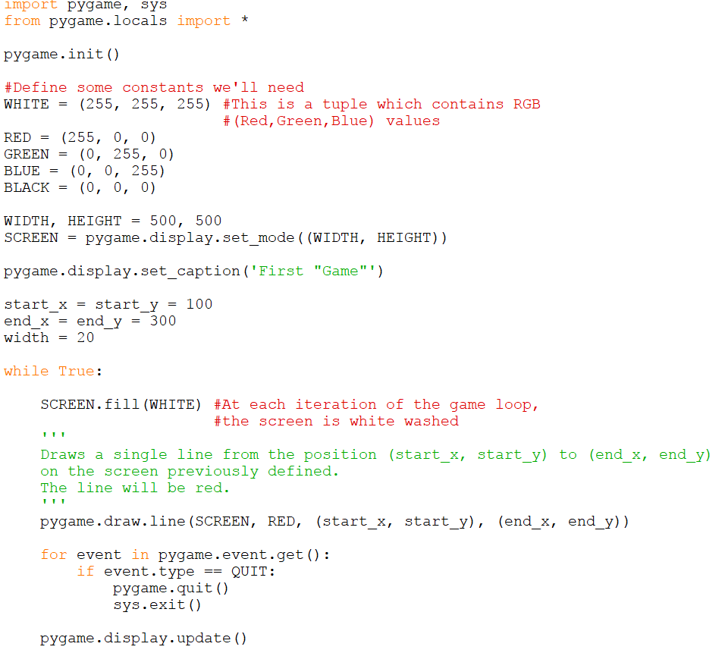
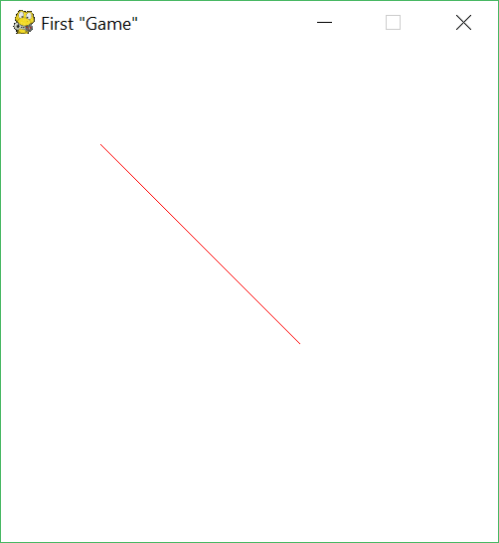
Drawing a line example (2)

Slide 23
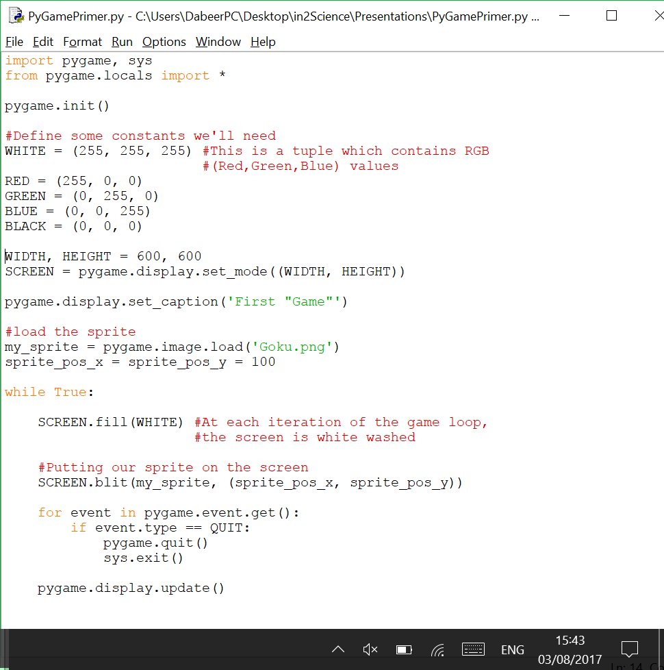
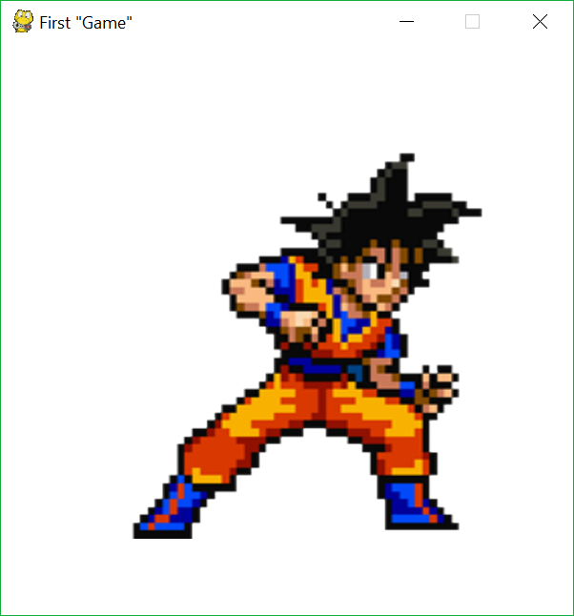
How to add sprites
Use: pygame.image.load(image_name, position_tuple)
#initialising sprite

Slide 24
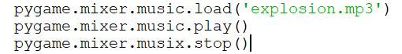
How to add sound
pygame.mixer.music.load(“Sound_File_name”)
You pass a string to the above function which loads the sound file for you to manipulate.
pygame.mixer.music.play()
Plays the sound
pygame.mixer.music.stop()
Stops the sound

Slide 25
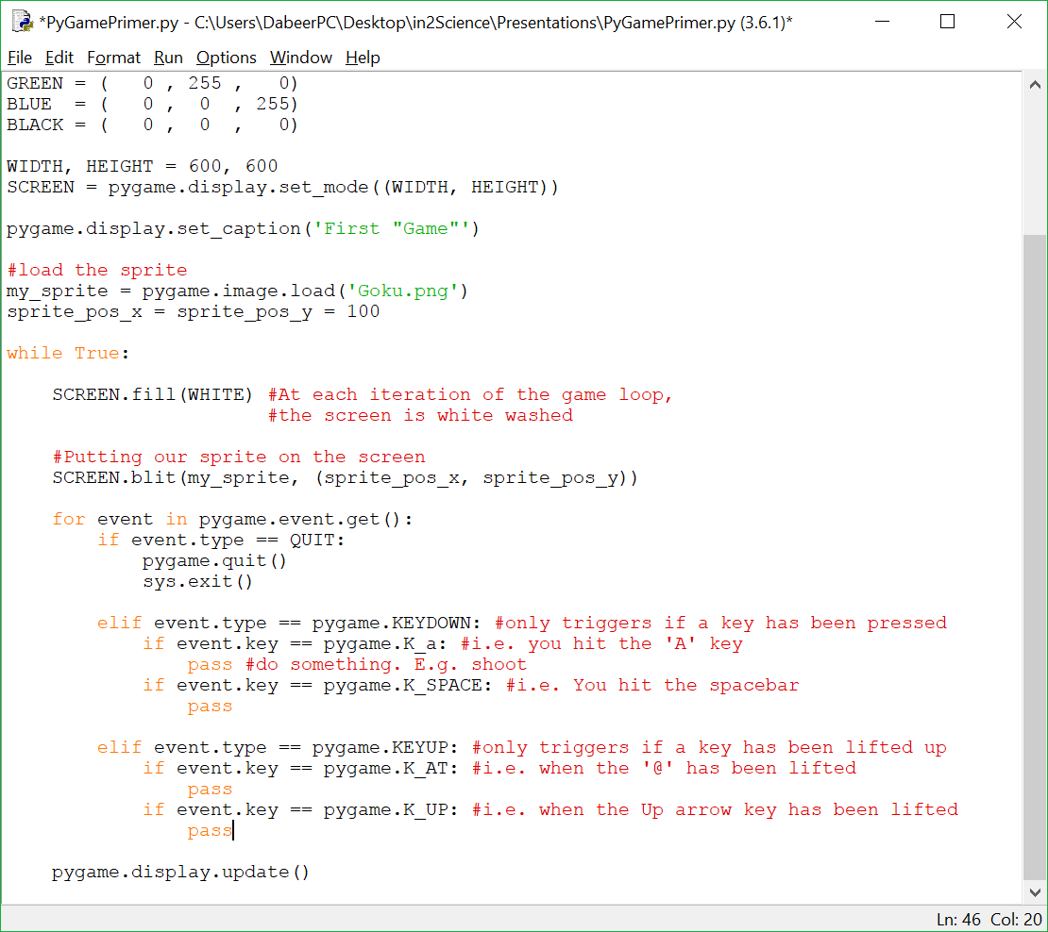
Keyboard input (1) – Discrete input
This form of input is used when you don’t want a continuous action (like movement) in a game to occur. E.g. You want the character to jump (continuous jumping doesn’t make sense). Input will occur once per frame.

Slide 26
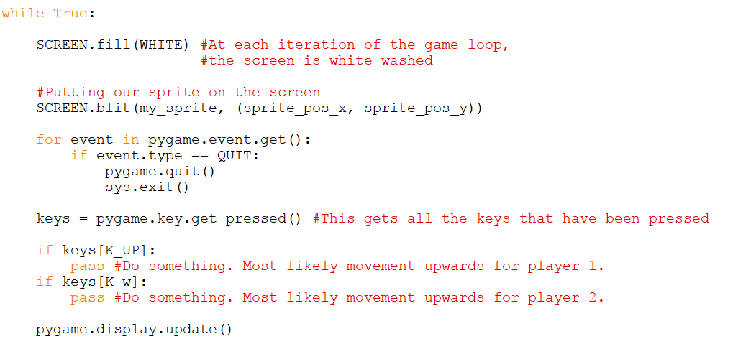
Keyboard input (2) – Continuous input
This form of input is used when you need continuous input (as I’m sure you inferred from the title!). This is used primarily for movement of characters/sprites.
This method is also used to get input for all players. i.e. Use this method for multiplayer games.

Slide 27
Keyboard Input (3) - Extras
For more information regarding input for various keys, please visit:
https://www.pygame.org/docs/ref/key.html

Slide 28
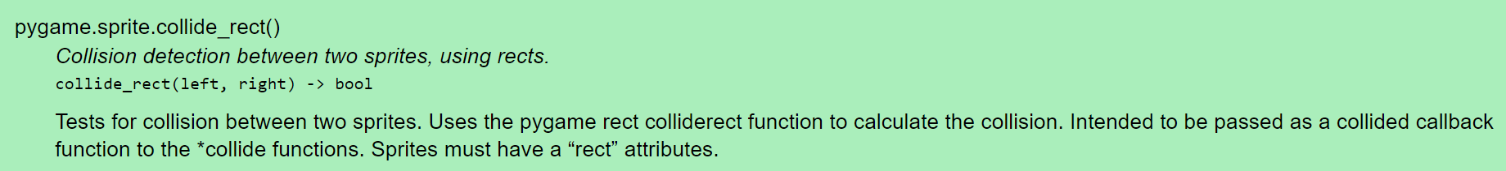
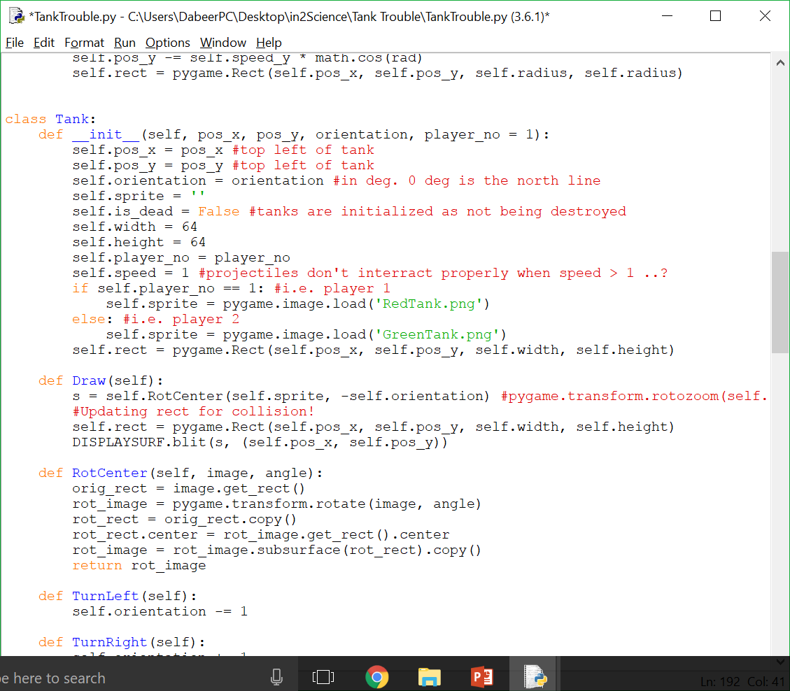
Collision Detection
First things first, you need to create an object (like a tank object for example). The object must have a sprite attribute and ‘Rect’ attribute (i.e. A rectangle object that covers the sprite).

Slide 29
So that concludes our PyGame Primer!
So this is simply a quick overview of what you’ll need for the summer school. If there’s anything you need to clarify/ go over, please don’t hesitate to ask Dabeer or James.
Alternatively, check the PyGame documentation at: https://www.pygame.org/docs/ (this will probably provide you with a quicker answer than Dabeer or James can come up with)
Some more resources:
https://www.reddit.com/r/pygame/
https://stackoverflow.com/
https://inventwithpython.com/makinggames.pdf

